Slide 1
SE 577 Software Architecture Basic SW Architectural Concepts

Slide 2
Acknowledgement
Material from several sources including:
Ian Gorton. Essential Software Architecture (2nd Edition), Springer-Verlag.
R.N. Taylor, N. Medvidovic, and E.M. Dashofy. Software Architecture: Foundations, Theory and Practice, Wiley.
Neil Ford & Mark Richards Software Architecture Fundementals

Slide 3
Architecture in a Traditional Project Life Cycle
Business Case
Planning and Architecture Phase
Requirements
Carries through the life of the project
Architecture
High Level Design
Detailed Design
This ”waterfall” approach represents the historic approach to doing architecture.

Slide 4
Architecture in an Agile Project Life Cycle
Create Reference Architecture – “how the proposed solution fits into the big picture”
Iterate
Create Solution Architecture for a Program Increment (approx. 5 Sprints)
Update Existing Architecture Decisions Define new architecture decisions that need to be made
Create Technical Architecture Guidance to Guide Engineering, Delivery and Testing
Monitor Engineering, ensuring architecture guidance is followed or creating a backlog for adjusting architecture
Perform Architecture Retrospective
Monitor overall architecture against agreed objectives
Consistently support activities needed in support of quality attributes – e.g., security, compliance, etc
Negotiate and Influence on behalf of architecture and engineering ongoing progress and required changes

Slide 5
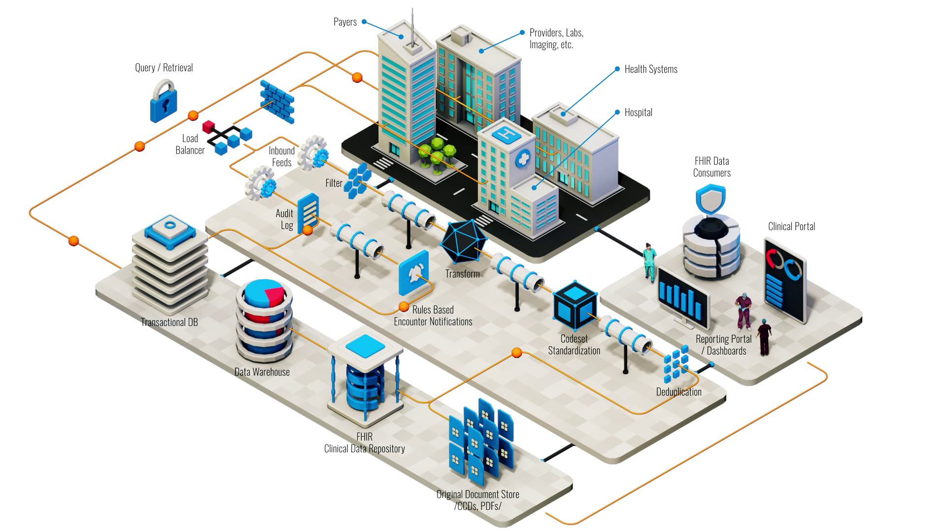
Example of Reference Architecture
Create Reference Architecture – “how the proposed solution fits into the big picture”
OBJECTIVE Improve timeliness of insights from healthcare delivery system to improve the patient experience and outcomes

Slide 6
Example: Architecture Kickoff
Create Reference Architecture – “how the proposed solution fits into the big picture”
OBJECTIVE Improve timeliness of insights from healthcare delivery system to improve the patient experience and outcomes
KEY ARCHITECTURE NEEDS
Pick a healthcare interoperability partner – partner must support real-time FHIR events
Identity key systems that must be adjusted to react to real time patient data Build new data insights engine to process events real time and to build actionable insights Modernize legacy systems to react in real time to key events of interest
Build analytics solution to measure effectiveness and patient outcomes

Slide 7
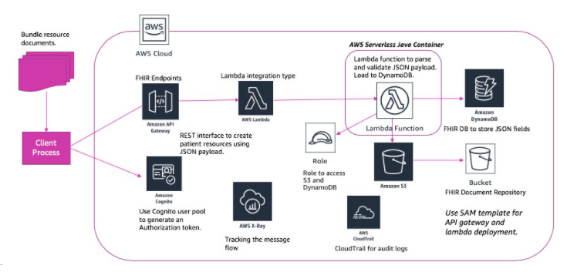
Example: Establish baseline solution architecture next
Create Solution Architecture – “how the proposed solution will be structured”
OBJECTIVE Employ cloud native architecture patterns to ensure resiliency, scale, and flexibility to ingest real-time clinical events
KEY ARCHITECTURE DECISIONS and GUIDENCE
Ensure that HIPAA privacy and security requirements are enforced in every component of the solution
Favor managed cloud services to support dynamic scalability and resiliency Ensure audit and control policies are supported by the solution via CloudFront
Ensure data is flexibly stored to support FHIR resource standards

Slide 8
Major Areas of Concern for Architectural Design
Requirements
Both functional and non-functional
OA&M (Operation Administration & Maintenance)
The set of procedures for initializing and administering the system.
Error Recovery
How does the system handle rainy day scenarios?

Slide 9
Requirements
Traditional SE suggests requirements analysis should remain unsullied by any consideration for a design.
However, without reference to existing architectures it becomes difficult to assess practicality, schedules, or costs.
Requirements analysis and consideration of design must be pursued at the same time.

Slide 10
Non-Functional Requirements
Non-Functional Requirements (NFRs) define “how” a system achieves its functional requirements.
NFRs include:
Quality attributes
Application performance must provide sub-four second response times for 90% of requests.
Technical constraints
The system must be written in Java so that we can use existing development staff.
Business constraints
“We want to work closely with and get more development funding from MegaHugeTech Corp, so we need to use their technology in our application.”

Slide 11
Non-Functional Requirements (cont’d)
NFRs rarely captured in functional requirements
They are also known as “architecture requirements”
Must be elicited by architect
Specification of NFR might require an architectural framework to even enable their statement.
An architectural framework will be required for assessment of whether the properties are achievable.

Slide 12
What is OA&M?
OA&M includes all the steps necessary to get and keep the system operational.
Manufacture the software for delivery and installation
Install the software
Convert required data
Initialize the database
Prime the tables
Start up the system
Connect to the outside world
Take it down for backups
Restart it after a failure
Update the software in the field
Etc., Etc., Etc.

Slide 13
What is OA&M? (cont’d)
OA&M is one of the most overlooked parts of the architecture.
Many systems leave this last and assume that the operators in the field will do what they have to do to keep the system operational.
OA&M has to be included in the original architecture because it is difficult (if not impossible) to add later.
Some view it as just the set of instructions that the system administrator is given, but this is just the tip of the iceberg.

Slide 14
Error Recovery
The system has to be designed from the standpoint of errors.
The sunny day paths are easy; the error handling is what complicates the system.
Must have a consistent approach for handling errors.
Error recovery (like OA&M) is often overlooked in the system architecture.

Slide 15
Error Recovery: Kinds Of Errors
Communication
Intermittent / interrupted communication
Unexpected / incorrect network changes
Process
Abnormal termination
Asleep waiting (patiently) for an event (which may never occur, or that has been missed).
Resource leaks
Coordination
Someone forgot to tell the up/downstream systems about the new data format.
Other systems in the network do not react kindly to a system going down due to a failure or for a scheduled upgrade

Slide 16
Software Architecture’s Elements
A software system’s architecture should be a composition and interplay of different elements
Processing
Data, also referred as information or state
Interaction

Slide 17
Components
Elements that encapsulate processing and data in a system’s architecture are referred to as software components
A software component is an architectural entity that:
Encapsulates a subset of the system’s functionality and/or data.
Restricts access to that subset via an explicitly defined interface.
Has explicitly defined dependencies on its required execution context.
Components typically provide application-specific services.

Slide 18
Connectors
A software connector is an architectural building block tasked with effecting and regulating interactions among components.
In complex systems interaction may become more important and challenging than the functionality of the individual components.
In many software systems connectors are usually simple procedure calls or shared data accesses.
Much more sophisticated and complex connectors are possible!
Connectors typically provide application-independent interaction facilities.

Slide 19
Examples of Connectors
Procedure call connectors
Shared memory connectors
Message passing connectors
Streaming connectors

Slide 20
Architecture Defines Structure
Decomposition of system into components/modules/subsystems
Architecture defines:
Component responsibilities
Precisely what a component will do when you ask it
Component interfaces
What a component can do
Component communications and dependencies
How components communicate

Slide 21
Architecture Specifies Component Communication
Communication involves:
Data passing mechanisms
Remote method invocation
Asynchronous message
Control flow
Sequential
Concurrent/parallel

Slide 22
An Important Concern: Structure and Dependencies
Excessive component dependencies are bad!
Key architecture issue
Identifying components that may change
Reduce direct dependencies on these components
Creates more modifiable systems
C1
C2
C3
C4
C1
C2
C3
C4
AL
Third Party
Component
Third Party
Component
Four components are directly dependent on a third party component. If the third party component is replaced with a new component with a different interface, changes to each component are likely.
Only the AL (abstraction layer) component is directly dependent on the third party component. If the third party component is replaced, changes are restricted to the AL component only
C
Diagram Key
Component
Dependency

Slide 23
Inter-Process Communication
Inter-process communication (IPC) refers to the activity of sharing data across multiple processes.
Processes, or applications, using IPC are categorized as clients and servers.
(In what follows we’ll use process to refer to either process or application.)
A client is a process that requests a service from some other process, or application.
A server is a process that responds to a client request.

Slide 24
IPC (cont’d)
Many processes act as both a client and a server, depending on the situation.
For example, a word processing application might act as a client in requesting a summary table of manufacturing costs from a spreadsheet application acting as a server.
The spreadsheet application, in turn, might act as a client in requesting the latest inventory levels from an automated inventory control application.

Slide 25
IPC (cont’d)
Reasons for implementing IPC systems:
Sharing information
Web servers use IPC to share web documents and media with users through a web browser.
Distributing labor across systems
An application uses multiple servers that communicate with one another using IPC to process user requests.
Privilege separation
Some GUI software is separated into layers based on privileges to minimize the risk of attacks. These layers communicate with one another using encrypted IPC.

Slide 26
IPC (cont’d)
Methods for achieving IPC are divided into categories which vary based on requirements such as performance and modifiability, network bandwidth, latency, etc.

Slide 27
Configurations
Components and connectors are composed in a specific way in a given system’s architecture to accomplish that system’s objective
An architectural configuration, or topology, is a set of specific associations between the components and connectors of a software system’s architecture.

Slide 28
Architecture Styles/Patterns
Patterns catalogue successfully used structures that facilitate certain kinds of component communication
Client-server
Message broker
Pipe-and-filter
Patterns have well-known characteristics appropriate for particular types of requirements
Patterns are very useful…
Reusable architectural blueprints
Help efficiently communicate a design
Large systems comprise a number of individual patterns
“Patterns and Styles are the same thing – the patterns people won” [anonymous SEI member]

Slide 29
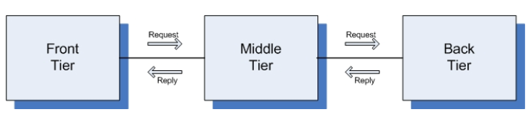
Three-Tiered Pattern
Front Tier
Contains the user interface functionality to access the system’s services
Middle Tier
Contains the application’s major functionality
Back Tier
Contains the application’s data access and storage functionality

Slide 30
Architectural Models, Views, and Visualizations
Architecture Model
An artifact documenting some or all of the architectural design decisions about a system
Architecture View
A subset of related architectural design decisions
Architecture Visualization
A way of depicting some or all of the architectural design decisions about a system to a stakeholder

Slide 31
Architecture Views
A software architecture represents a complex design artifact
Many possible ‘views’ of the architecture
Cf. with buildings – floor plan, external, electrical, plumbing, air-conditioning

Slide 32
Architecture Views (cont’d)
Logical view: describes architecturally significant elements of the architecture and the relationships between them.
Process view: describes the concurrency and communications elements of an architecture.
Physical view: depicts how the major processes and components are mapped on to the applications hardware.
Development view: captures the internal organization of the software components as held in e.g. a configuration management tool.

Slide 33
Architecture Views (cont’d)
Marketecture
Informal depiction of system’s structure and interactions.
Portray the design philosophies embodied in the architecture.
Every system should have a marketecture:
Easy to understand.
Helps discussion during design, build, review, sales (!) activities.

Slide 34
WWW in a (Big) Nutshell
The Web is a collection of resources, each of which has a unique name known as a uniform resource locator, or “URL”.
Each resource denotes, informally, some information.
URLs can be used to determine the identity of a machine on the Internet, known as an origin server, where the value of the resource may be ascertained.
Communication is initiated by clients, known as user agents, who make requests of servers.
Web browsers are common instances of user agents.

Slide 35
WWW in a (Big) Nutshell (cont’d)
Resources can be manipulated through their representations.
HTML is a very common representation language used on the Web.
All communication between user agents and origin servers must be performed by a simple, generic protocol (HTTP), which offers the command methods GET, POST, etc.
All communication between user agents and origin servers must be fully self-contained. (So-called “stateless interactions”)

Slide 36
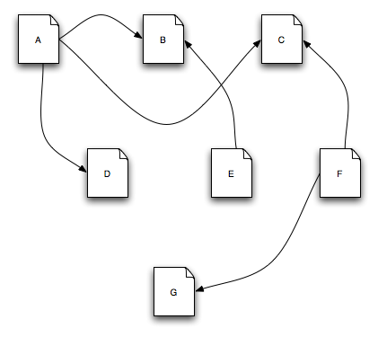
The Architecture of the WWW
This is the Web

Slide 37
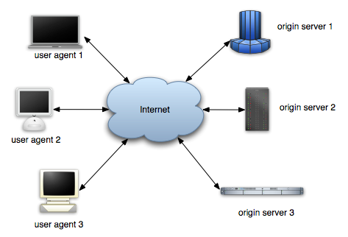
The Architecture of the WWW (cont’d)
So is this

Slide 38
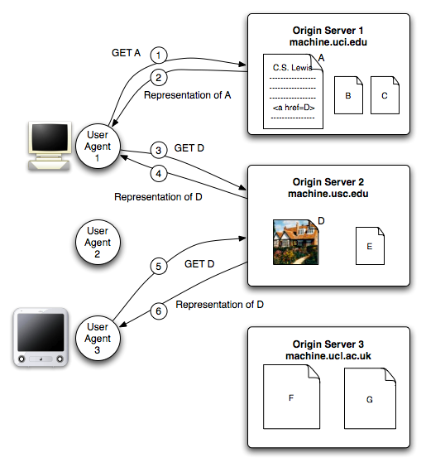
The Architecture of the WWW (cont’d)
And this

Slide 39
WWW’s Architecture
Architecture of the Web is wholly separate from the code.
There is no single piece of code that implements the architecture.
There are multiple pieces of code that implement the various components of the architecture.
E.g., different Web browsers

Slide 40
WWW’s Architecture (cont’d)
Stylistic constraints of the Web’s architectural style are not apparent in the code
The effects of the constraints are evident in the Web
One of the world’s most successful applications is only understood adequately from an architectural vantage point.

Slide 41
Prescriptive vs. Descriptive Architecture
A system’s prescriptive architecture captures the design decisions made prior to the system’s construction
It is the as-conceived or as-intended architecture
A system’s descriptive architecture describes how the system has been built
It is the as-implemented or as-realized architecture

Slide 42
Temporal Aspect
Architecture has a temporal aspect
Design decisions are made over a system’s lifetime
A system’s architecture will change over time
At any given point in time the system has only one architecture

Slide 43
As-Designed vs. As-Implemented Architecture
Which architecture is “correct”?
Intent vs. added experience of implementation
Are the two architectures consistent with one another?
Architectural inconsistencies can be much more complex and/or insidious.
What criteria are used to establish the consistency between the two architectures?
Sophisticated techniques might be needed
On what information is the answer to the preceding questions based?
Diagrams may not contain adequate information

Slide 44
Architectural Evolution
When a system evolves, ideally its prescriptive (as-designed) architecture is modified first.
In practice, the system – and thus its descriptive (as-implemented) architecture – is often directly modified.
This happens because of:
Developer sloppiness
Perception of short deadlines which prevent thinking through and documenting
Lack of documented prescriptive architecture
Need or desire for code optimizations
Inadequate techniques or tool support

Slide 45
Architectural Degradation
Two related concepts
Architectural drift
Architectural erosion
Architectural drift is introduction of principal design decisions into a system’s descriptive architecture that
Are not included in, encompassed by, or implied by the prescriptive architecture
But which do not violate any of the prescriptive architecture’s design decisions
Architectural erosion is the introduction of architectural design decisions into a system’s descriptive architecture that violate its prescriptive architecture

Slide 46
Architectural Recovery
If architectural degradation is allowed to occur, one will be forced to recover the system’s architecture sooner or later
Architectural recovery is the process of determining a software system’s architecture from its implementation-level artifacts
Implementation-level artifacts can be
Source code
Executable files
Java .class files

Slide 47
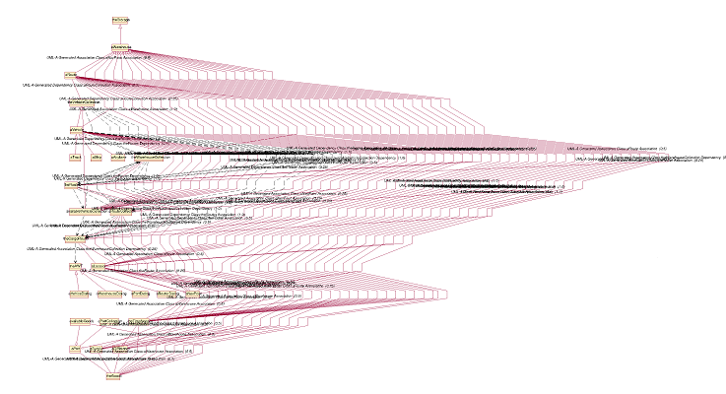
Implementation-Level View of an Application
Complex and virtually incomprehensible!

